Slide 1
0.5-11 GHz Analog Fiber-Optic Links for the Allen Telescope Array--Additional Data
Link Design and Component Down-Select
June 7, 2002
Edward Ackerman and Harold Roussell
781 272-1819
1

Slide 2
PSI Measurements on Links with Integrated Laser/EA Modulators—Past Work
Three previously sent packages of data (9/12/01, 11/9/01, 1/31/02) showed 0.5-11 GHz performance of “Link 1”:
  Fujitsu integrated laser/EA modulator #1
  1 km SM fiber
  Discovery photodetector
Since 1/31/02 PSI has taken delivery of three additional Fujitsu devices, plus an NEC integrated laser/EA modulator
SETI requested that PSI perform the following additional measurements:
  Link response (magnitude and phase) vs temperature
  Link performance variation (among several Fujitsu devices)
2

Slide 3
PSI Measurements on Links with Integrated Laser/EA Modulators—New Work
Link *
Laser/EA Modulator
Freq Response vs Bias **
Intermods vs Bias **
NF, SFDR at Min₃ Bias **
NF, SFDR at Min₂ Bias **
Freq Response vs T ***
Link consists of laser/EA modulator + 1 km SM fiber + Discovery photodetector
Measurements vs bias performed at room temperature
Frequency response vs T measured at Min₃ bias
# 1
Fujitsu
# 1M20329
# 2
Fujitsu
# 18340
# 3
Fujitsu
# 18341
# 4
Fujitsu
# 18342
# 5
NEC
# 128













Reported previously


*
**
***
3

Slide 4
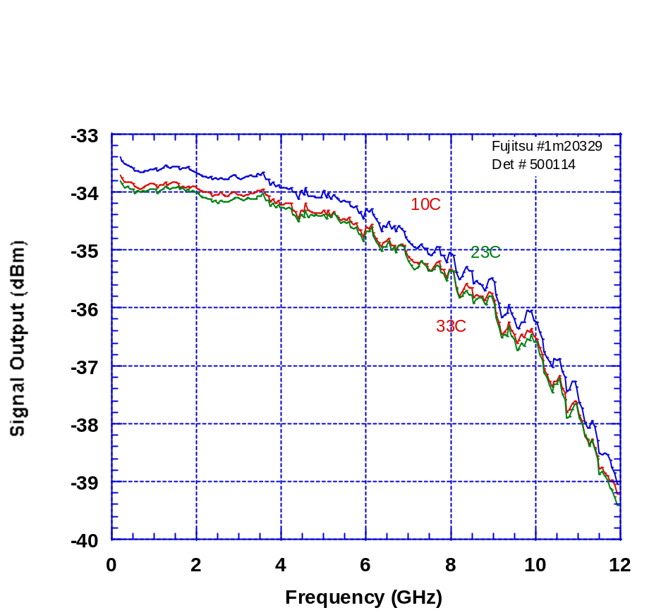
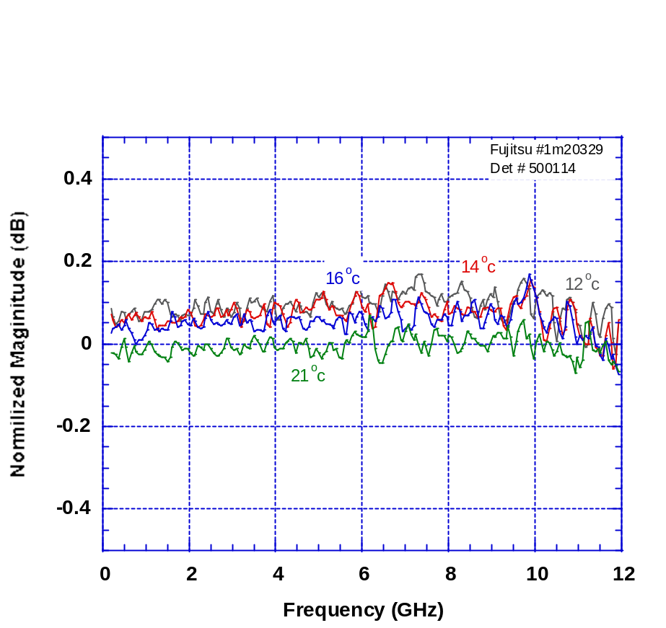
Frequency Response vs Temperature
Link 1: Fujitsu Laser/EA Modulator # 1M20329
In temperature chamber:
~ 0.5 m coax cable, laser/EA modulator, ~1 km SM fiber, detector, ~ 0.5 m coax
Absolute Magnitude vs T
10 – 30 °C
Relative Magnitude vs T
12 – 21 °C
4

Slide 5
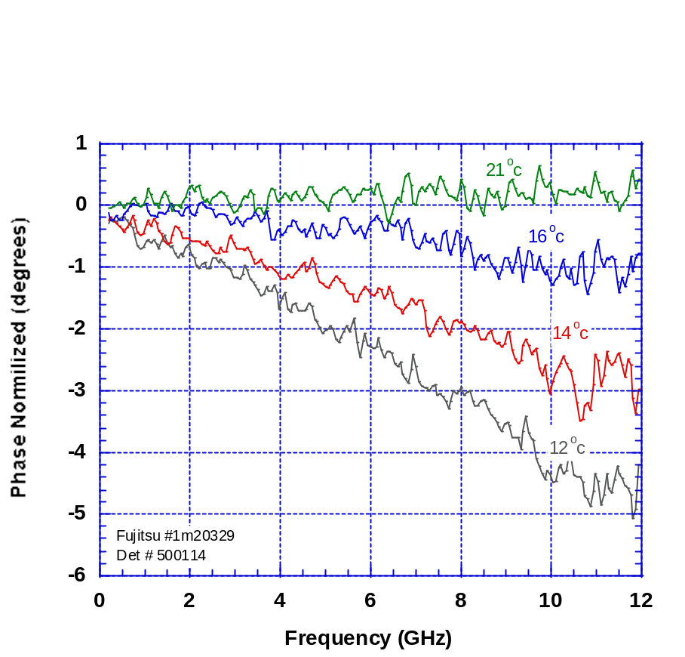
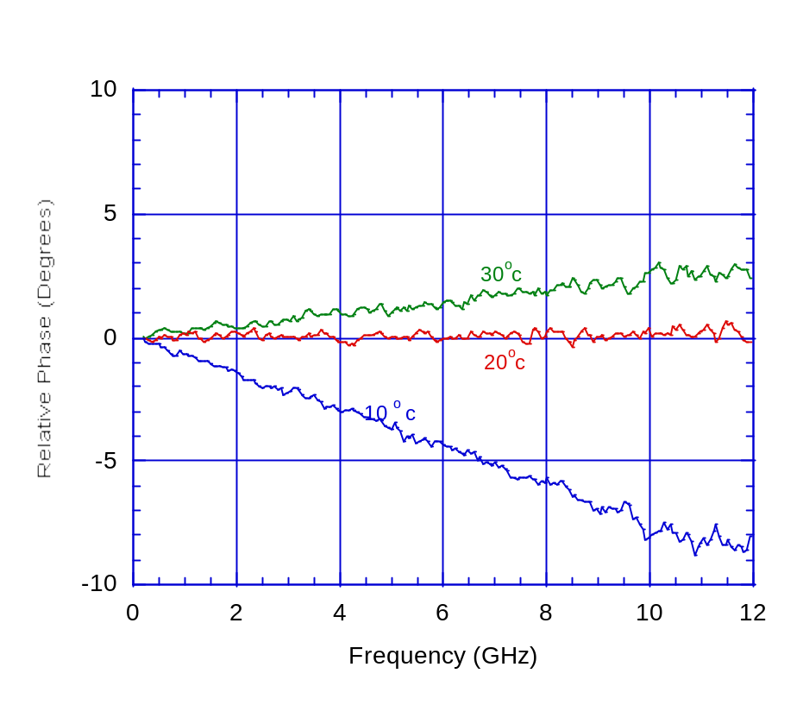
Frequency Response vs Temperature
Link 1: Fujitsu Laser/EA Modulator #1M20329
In temperature chamber:
~ 3 in. coax cable, laser/EA modulator, ~1 km SM fiber, detector, ~ 3 in. coax
Relative Phase (Degrees)
Relative Phase vs T
10 – 30 °C
Relative Phase vs T
12 – 21 °C
5

Slide 6
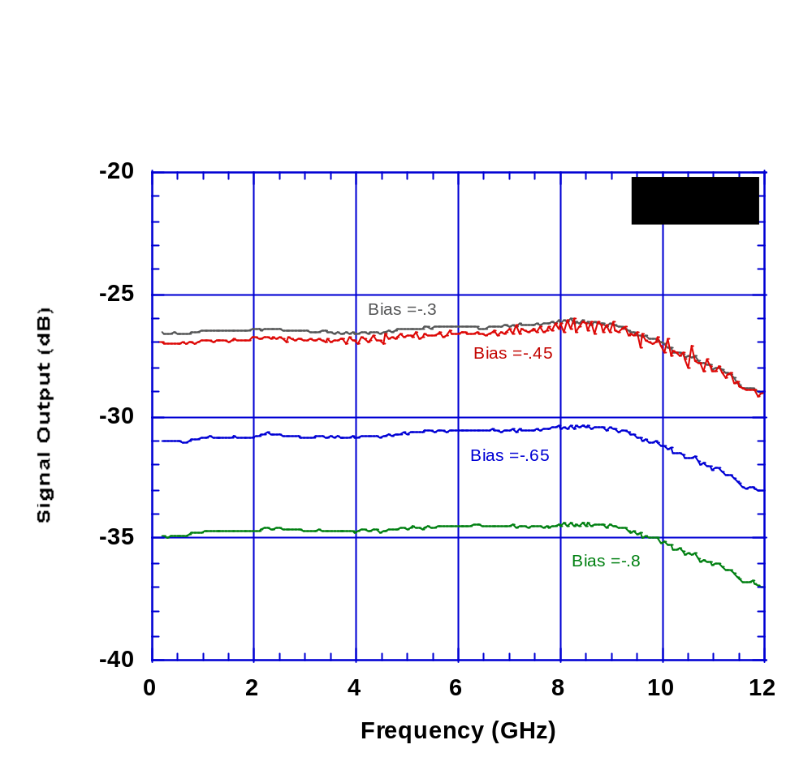
Frequency Response vs Bias
Link 2: Fujitsu Laser/EA Modulator # 18340
Results:
G_{11 GHz} ~ – 32 dB
BW_{3dB} > 12 GHz
ΔG_{0.5-11 GHz} ~ 1.5 dB
~ 1.5 dB
< 3 dB
6

Slide 7
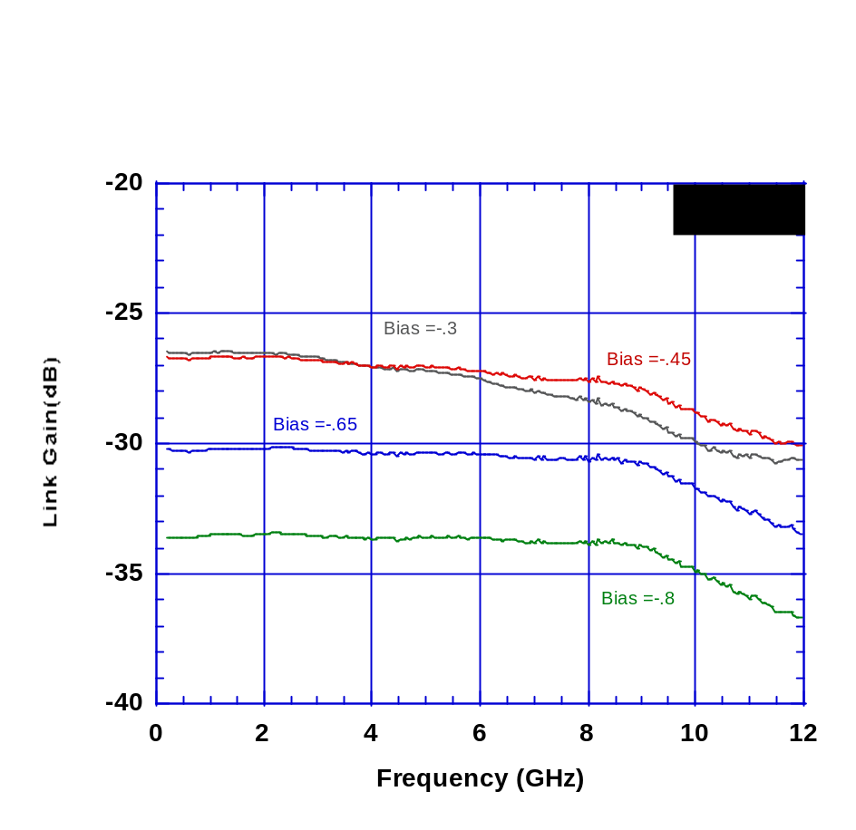
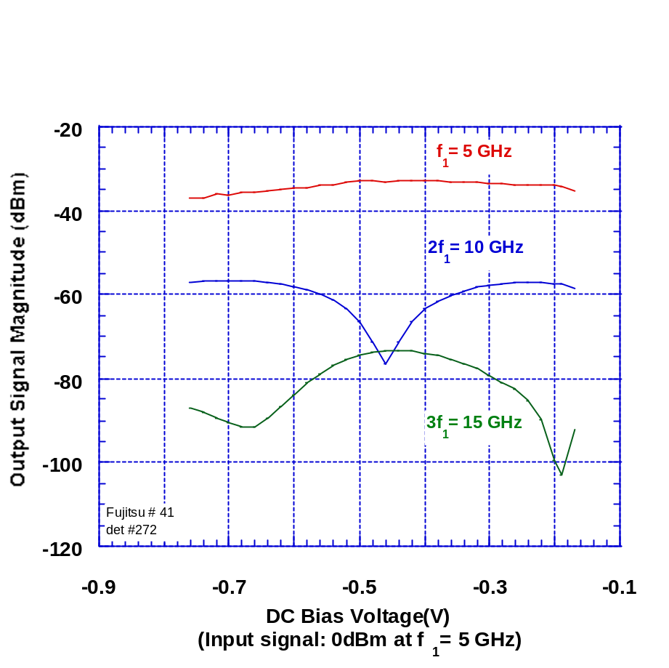
Frequency Response and Distortion vs. Bias
Link 3: Fujitsu Laser/EA Modulator # 18341
Measured Link Frequency Response vs. Modulator Bias Voltage
Min₂ Bias Voltage
1st Min₃ Bias Voltage
2nd Min₃ Bias Voltage
~ 2.5 dB
3 dB
At Min₃ Bias Voltage (~ -0.65 V): BW_{3dB} > 11.5 GHz
G_{11 GHz} ~ – 32.5 dB
ΔG_{0.5-11 GHz} ~ 2.5 dB

7

Slide 8
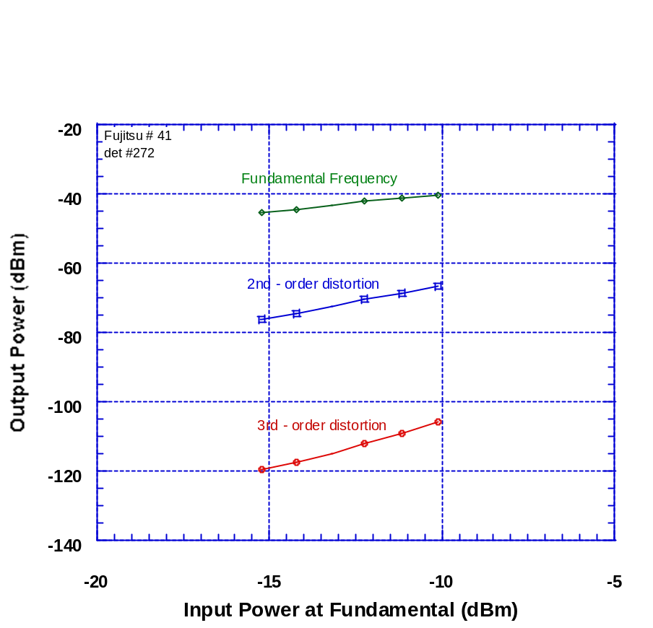
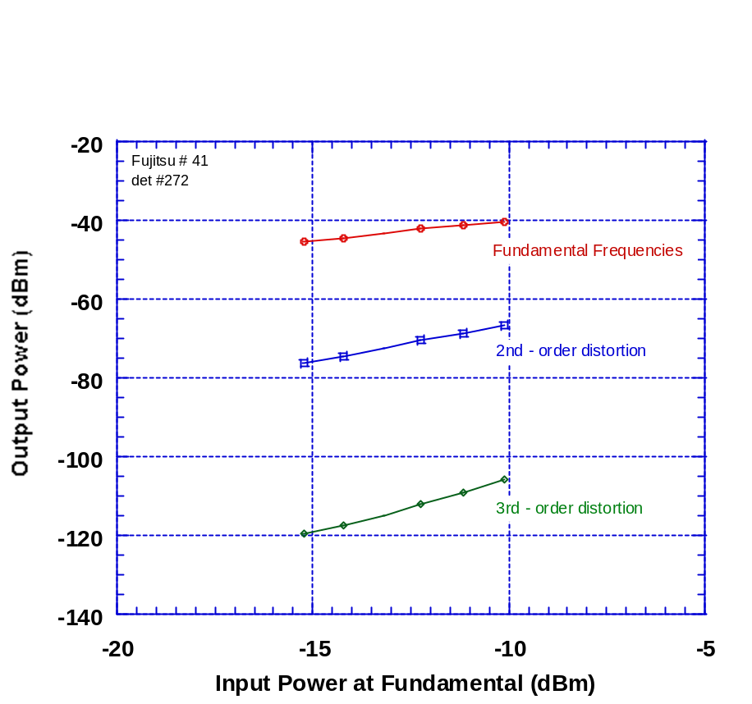
Noise Figure and Dynamic Range
Link 3: Fujitsu Laser/EA Modulator # 18341
Measured Distortion Products
Modulator biased at 1st 3rd-order Min (-0.18 V), detector bias = 6 V, fundamental frequencies ~ 5 GHz
Measured Distortion Products
Modulator biased at 2nd 3rd-order Min (-0.68 V), detector bias = 6 V, fundamental frequencies ~ 5 GHz
NF ≤ 41 dB
SFDR₃ ≥ 100 dB·Hz^{2/3}
SFDR₂ ≥ 73 dB·Hz^{1/2}
NF ≤ 36.5 dB
SFDR₃ ≥ 103.5 dB·Hz^{2/3}
SFDR₂ ≥ 75.5 dB·Hz^{1/2}
8

Slide 9
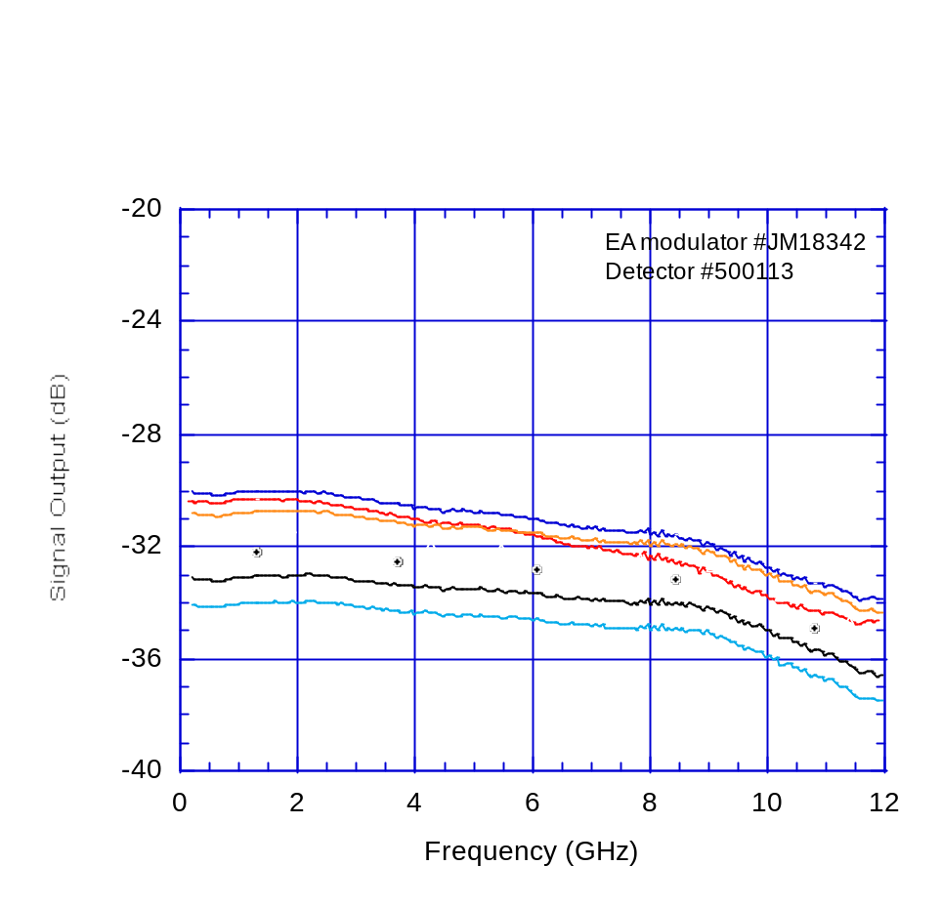
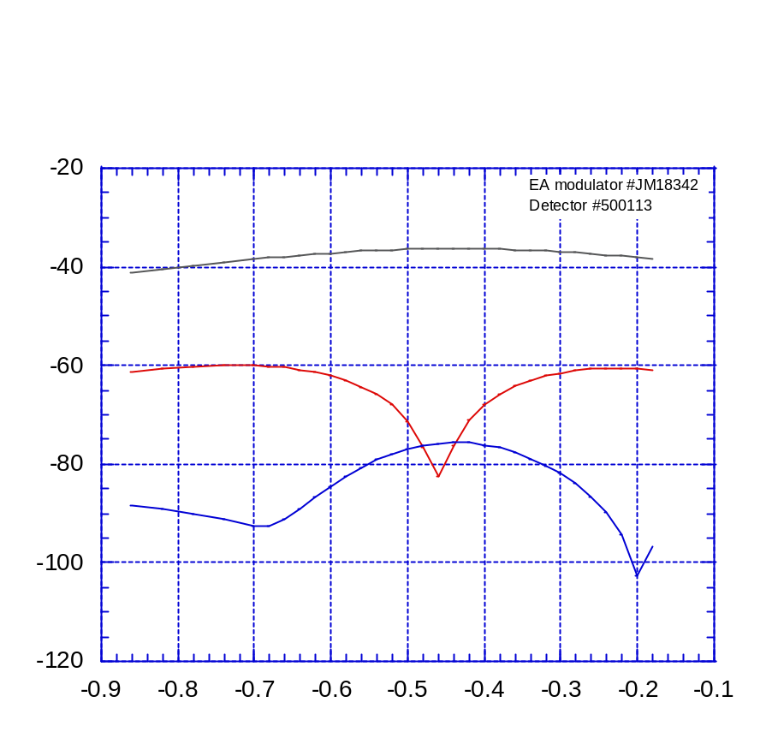
Frequency Response and Distortion vs. Bias
Link 4: Fujitsu Laser/EA Modulator # 18342
Measured Link Frequency Response vs. Modulator Bias Voltage
Min₂ Bias Voltage
Min₃ Bias Voltage
f₁ = 5 GHz
Output Signal Magnitude (dBm)
2f₁ = 10 GHz
Link Gain (dB)
Bias = –0.4 V
Bias = –0.5 V
Bias = –0.65 V
Bias = –0.3 V
~ 2.5 dB
3 dB
Bias = –0.7 V
3f₁ = 15 GHz
DC Bias Voltage (V)
At Min₃ Bias Voltage (~ -0.65 V): BW_{3dB} > 11.5 GHz
G_{11 GHz} ~ – 35.5 dB
ΔG_{0.5-11 GHz} ~ 2.5 dB

(Input signal: 0 dBm at f₁ = 5 GHz)
9

Slide 10
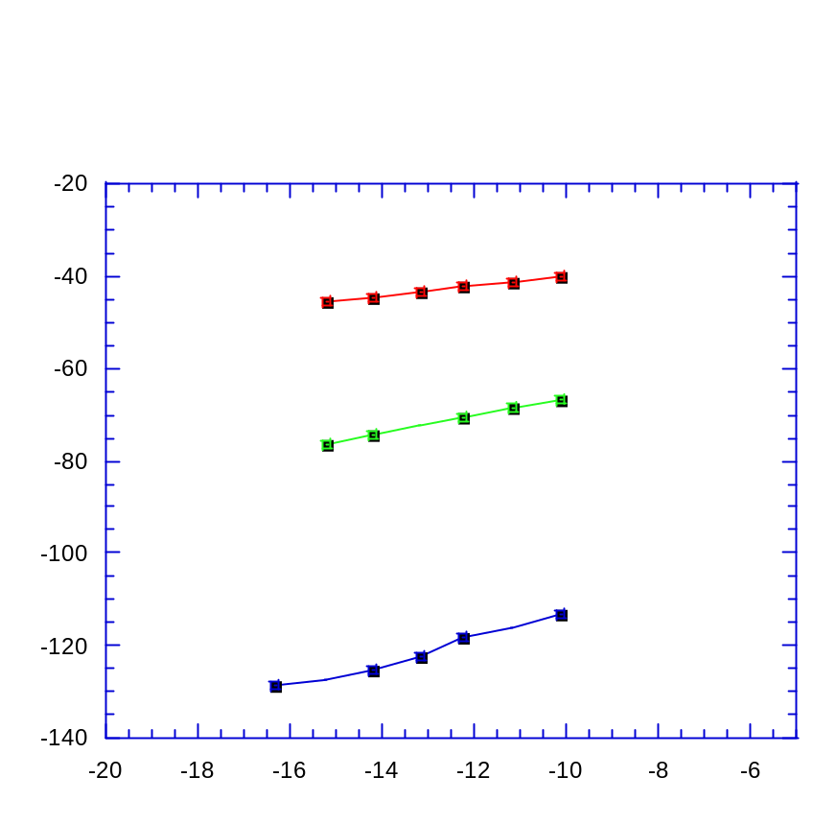
Noise Figure and Dynamic Range
Link 4: Fujitsu Laser/EA Modulator # 18342
Measured Distortion Products
Modulator biased at 2nd 3rd-order Min (-0.68 V), detector bias = 6 V, fundamental frequencies ~ 5 GHz
Fundamental
Output Power (dBm)
2nd-order distortion product
3rd-order distortion product
Input Power at Fundamental (dBm)
NF ≤ 38.5 dB
SFDR₃ ≥ 104.5 dB·Hz^{2/3}
SFDR₂ ≥ 74 dB·Hz^{1/2}
10

Slide 11
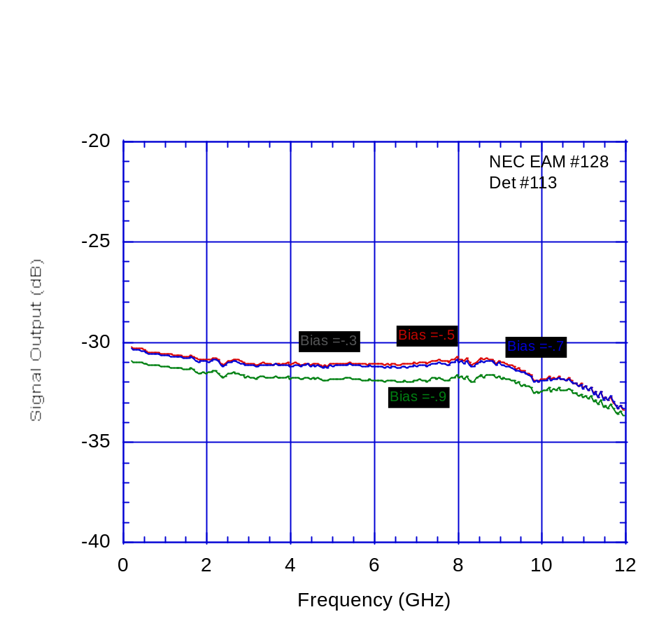
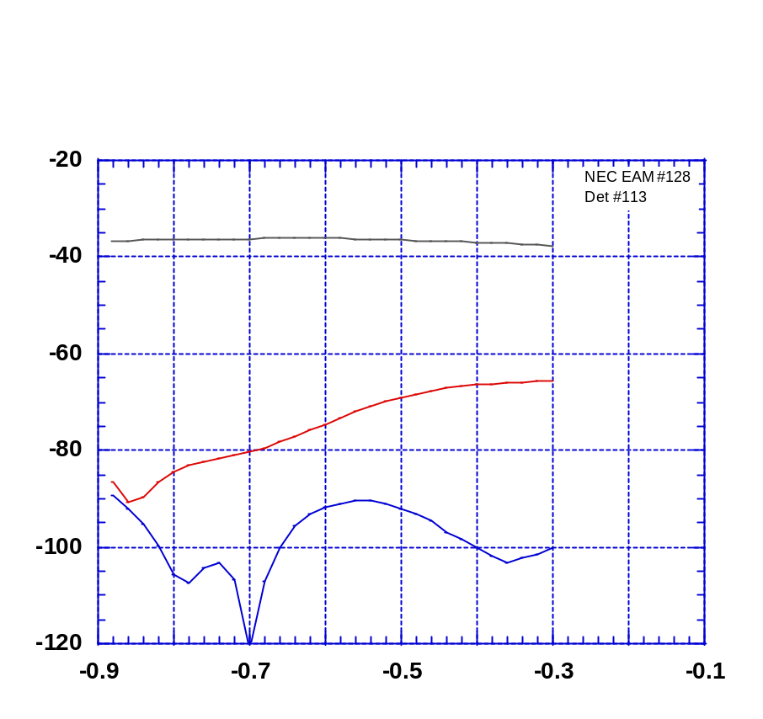
Frequency Response and Distortion vs. Bias
Link 5: NEC Laser/EA Modulator # 128
Measured Link Frequency Response vs. Modulator Bias Voltage
Min₂ Bias Voltage
Min₃ Bias Voltage
f₁ = 5 GHz
Link Gain (dB)
2f₁ = 10 GHz
Output Signal Magnitude (dBm)
~ 2 dB
3 dB
3f₁ = 15 GHz
DC Bias Voltage (V)
At Min₃ Bias Voltage (~ -0.65 V): BW_{3dB} ~ 12 GHz
G_{11 GHz} ~ – 32.5 dB
ΔG_{0.5-11 GHz} ~ 2 dB

(Input signal: 0 dBm at f₁ = 5 GHz)
11

Slide 12
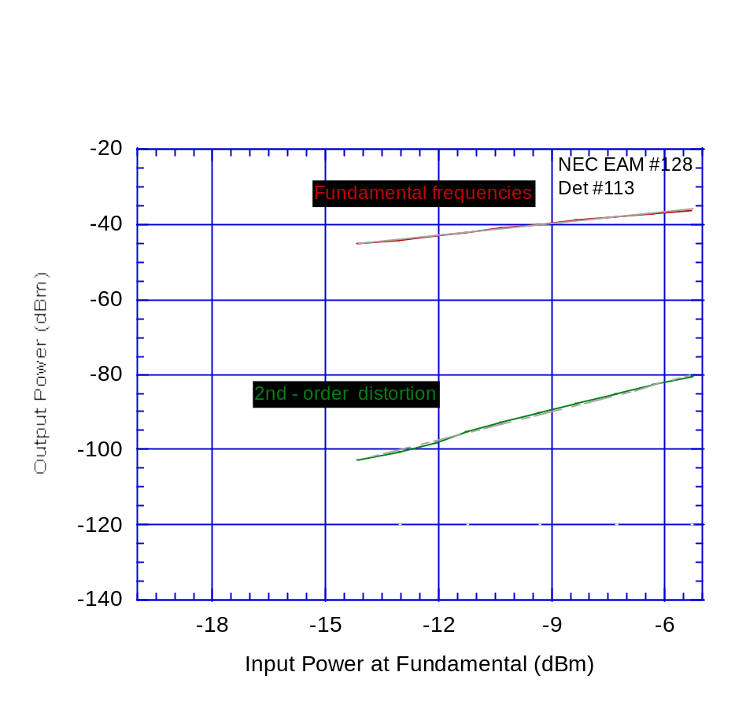
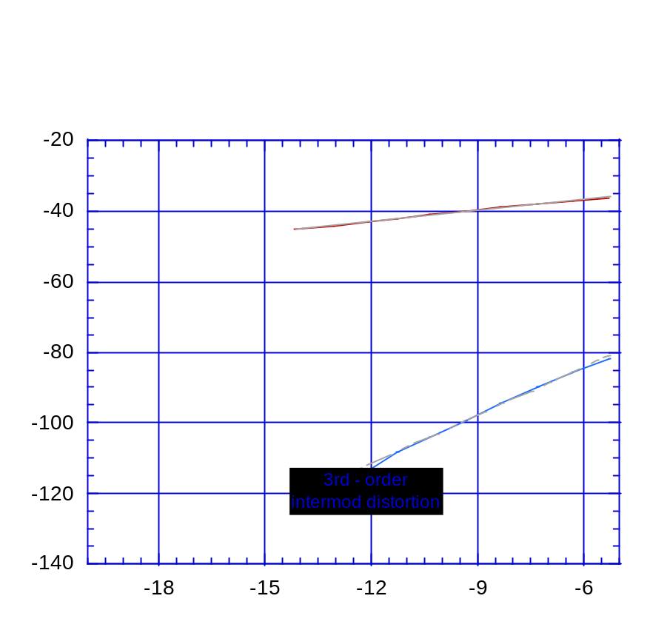
Noise Figure and Dynamic Range
Link 5: NEC Laser/EA Modulator # 128
Measured Distortion Products
Modulator biased at 2nd 3rd-order Min (-0.7 V), detector bias = 6 V, fundamental frequencies ~ 5 GHz
NF ≤ 39.5 dB
SFDR₃ ≥ 101.5 dB·Hz^{2/3}
SFDR₂ ≥ 88 dB·Hz^{1/2}
12

Slide 13
Measured Performance* and Cost** of Five Links
Link
1 (Fujitsu # 1M20329)
2 (Fujitsu # 18340)
3 (Fujitsu # 18341)
4 (Fujitsu # 18342)
5 (NEC # 128)
G_{0.5 GHz}
(dB)
– 35
– 31
– 30.5
– 33
– 30
G_{11 GHz}
(dB)
– 38.5
– 32
– 32.5
– 35.5
– 32
NF *
(dB)
45
___
41
38.5
39.5
SFDR₃*
(dB·Hz^{2/3})
102
___
100
104.5
101.5
SFDR₂*
(dB·Hz^{1/2})
76
___
73
74
88
Cost**
2,135
2,135
2,135
2,135
2,135
*
**
Worst-case performance is quoted (this is usually at 11 GHz)
Cost is for 1,000 links.
13

